Slide 1





Bayesian Graphical Modeling
Theory
PsyNets Winterschool 2026
n.sekulovski@uva.nl
bayesiangraphicalmodeling.com

Slide 2
Setup Today
Estimating & Testing
Network Comparison
Clustering
Morning Session
Afternoon Session

Slide 3
Setup Today
Estimating & Testing
Network Comparison
Clustering
Morning Session
Afternoon Session

Slide 4




Session setup
Part I: Theory
Part II: Practical
Part III: Project
image: Flaticon.com

Slide 5
Priors on the network structure
The prior on the structure, p(G), says which network structures we consider plausible before seeing the data.
Specifying it is one of the defining features of Bayesian graphical modeling.

Slide 6
Two structure priors so far
Bernoulli — each edge is included with a fixed and independent probability.
Beta–Bernoulli — a prior on the overall network density.

Slide 7
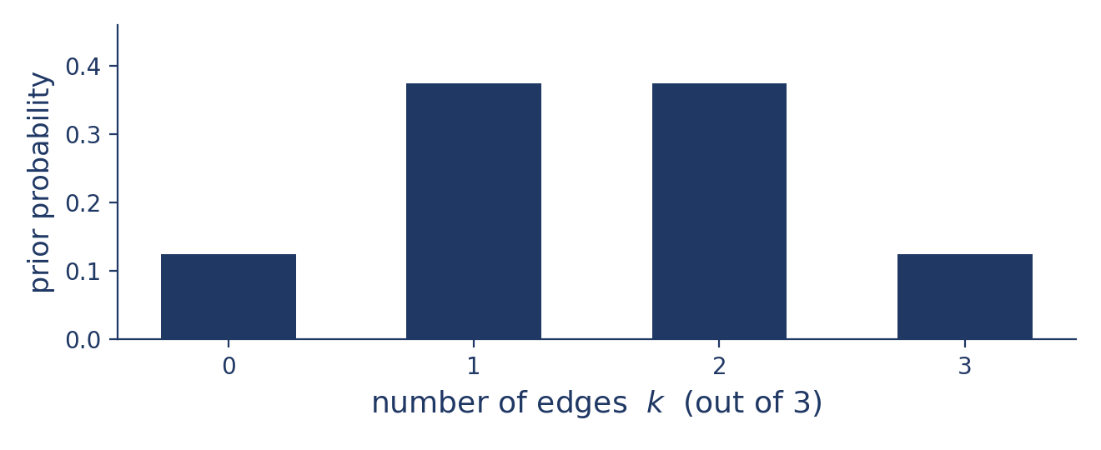
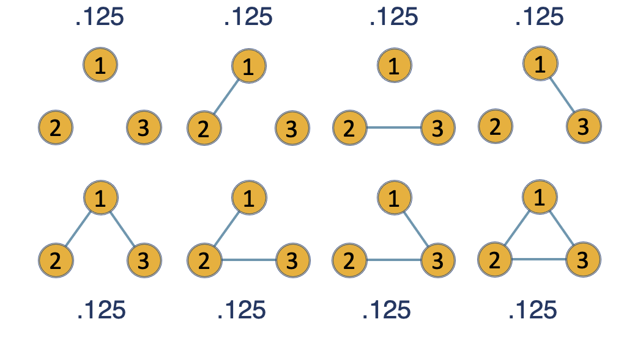
The Bernoulli prior
Each edge is included independently with a fixed probability π (default π = 0.5).
With π = 0.5 every network structure is equally likely a priori.
But the density is then binomial: most prior mass sits near half the edges, so very sparse or very dense networks are unlikely.

Slide 8
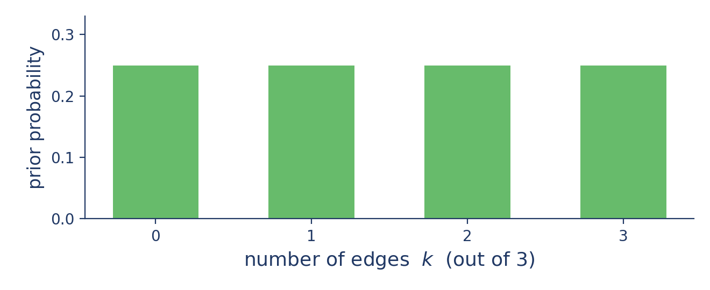
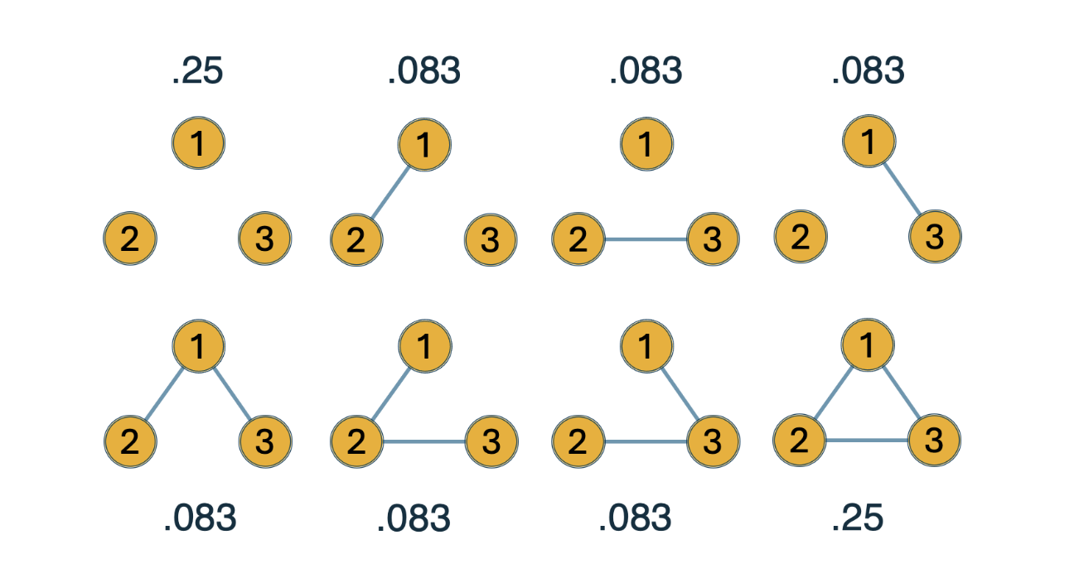
The Beta–Bernoulli prior
Instead of fixing π, place a Beta(α, β) prior on it
Beta(1, 1) makes every density equally likely (uniform over the number of edges).
This automatically corrects for multiple testing.

Slide 9
What they cannot express
Neither prior can say that the variables form clusters.
Yet clustering is exactly what many psychological theories predict.

Slide 10
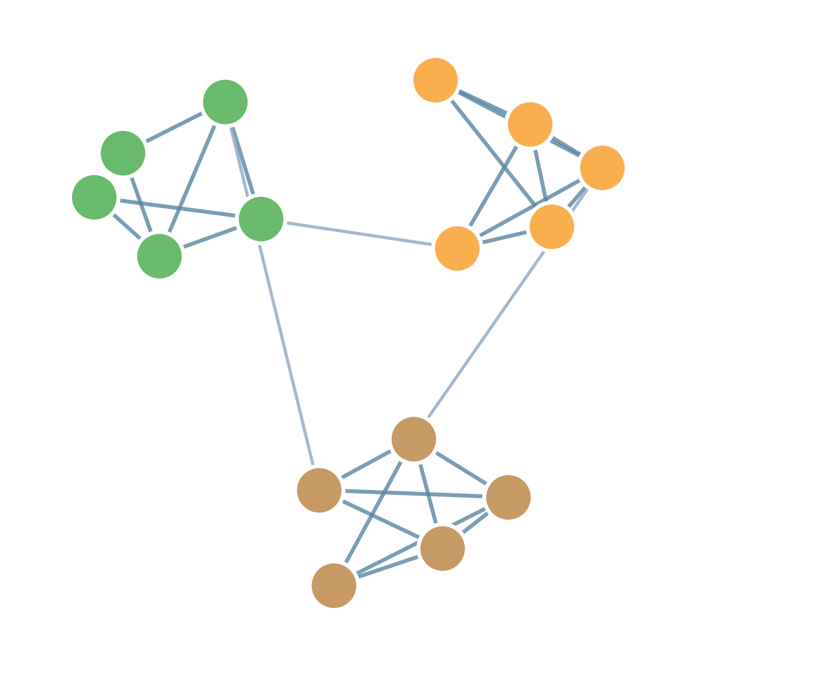
Clustering in psychological networks
Intelligence, personality, and psychopathology all assume variables group into clusters (communities).
Connections are dense within a cluster and sparse between clusters — sometimes linked by a few bridge nodes.

Slide 11
What is a cluster?
A cluster (block / community) is a set of nodes that are more densely connected to each other than to the rest of the network.

Slide 12
Two ways to find clusters
Post-hoc: first estimate the network, then run a community-detection algorithm on it (e.g. EGA).
Model-based: build the clustering assumption into the prior itself and then estimate and test it.
The Stochastic Block Model takes the second route.

Slide 13
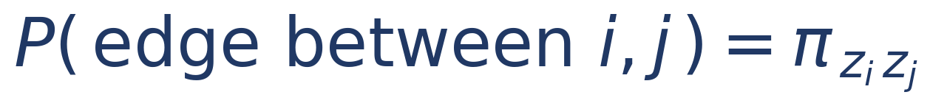
The Stochastic Block Model (SBM) prior
Put the clustering assumption directly into p(G).
Each node belongs to one of B latent blocks; the label of node i is zᵢ.
The probability of an edge depends only on the blocks of the two nodes:
Sekulovski, N., Arena, G., Haslbeck, J. M. B., Huth, K. B. S., Friel, N., & Marsman, M. (2025). A stochastic block prior for clustering in graphical models. PsyArXiv.
https://doi.org/10.31234/osf.io/29p3m_v4

Slide 14
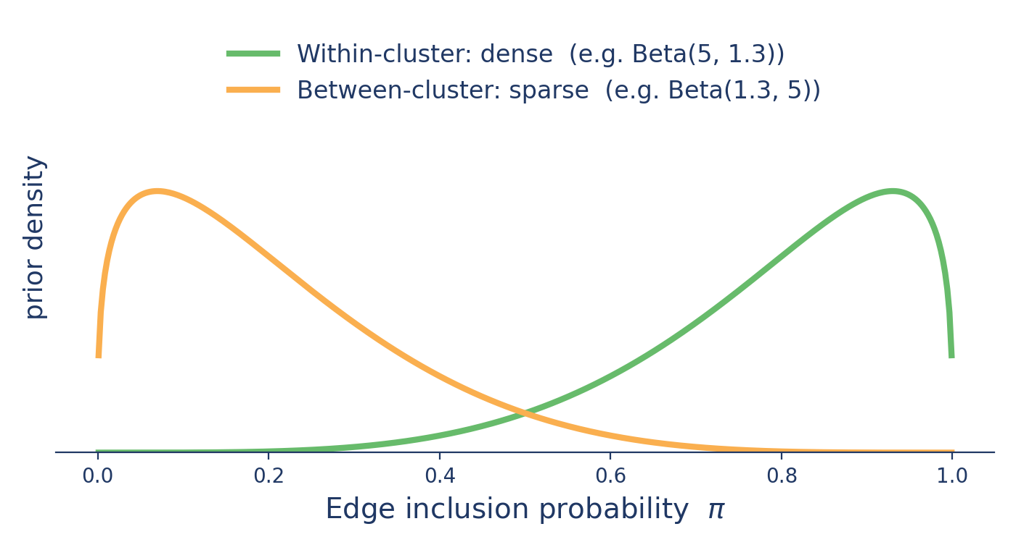
Dense within, sparse between
Two separate Beta–Bernoulli priors on edge inclusion:
within a block — edges are more likely;
between blocks — edges are less likely.

Slide 15
The SBM generalizes the Beta-Bernoulli
With a single block (B = 1), every edge is within-cluster, so the SBM prior is exactly the Beta–Bernoulli prior.
With B > 1 it adds the possibility of multiple clusters

Slide 16
The number of clusters B
Usually we do not know the number of clusters in advance.
So the block labels z and the number of blocks B become parameters, estimated from the data.
We place a prior on B (a truncated Poisson):

Slide 17
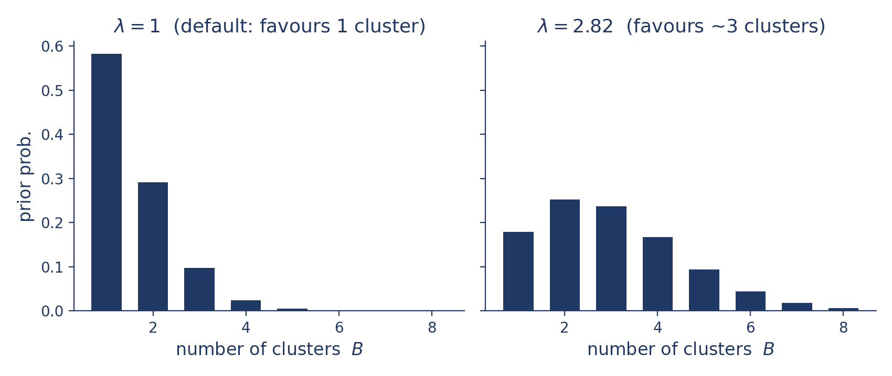
Hyperparameter 1: how many clusters?
λ is the rate of the truncated Poisson on B: it controls the expected number of clusters a priori.

Slide 18
Hyperparameter 1: how many clusters?
λ is not exactly the expected number of clusters, but tracks it closely:
λ = 1 → ~1 cluster (default)
λ = 1.59 → ~2 clusters
λ = 2.82 → ~3 clusters
λ = 3.92 → ~4 clusters
For 5 or more, set λ to the expected number.

Slide 19
Hyperparameter 2: within / between density
A Beta prior for within-block edges and a separate Beta prior for between-block edges.
Make within-block inclusion lean toward 1 and between-block lean toward 0 to encode dense-within, sparse-between.
Defaults are uniform, Beta(1, 1), for both.

Slide 20
Hyperparameter 3: cluster-size balance
A Dirichlet(ε) prior controls how evenly nodes spread across clusters.
Large ε → similar-sized clusters; small ε → some large, some tiny.
Default ε = 1 is neutral

Slide 21
From prior to clustering analysis
With the SBM prior, clustering emerges during estimation. We can now:
estimate the number of clusters,
test whether there is clustering at all,
estimate which nodes cluster together.

Slide 22
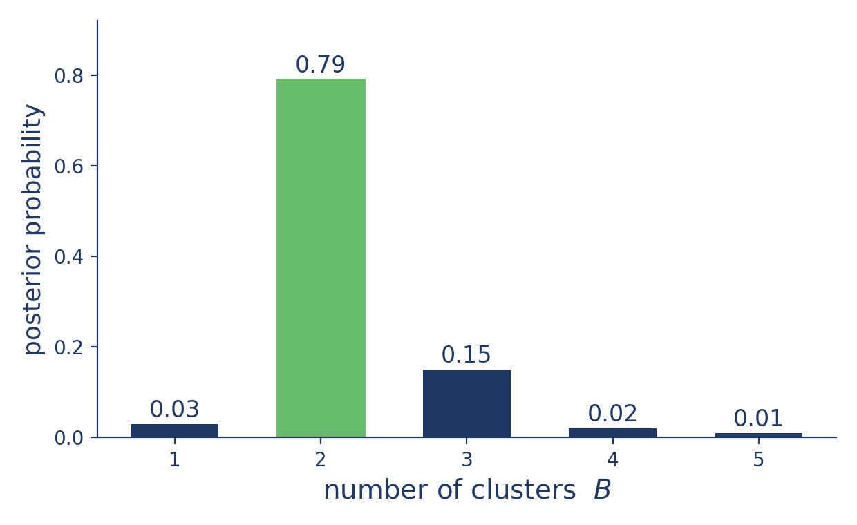
Output 1: posterior over the number of clusters
How many clusters does the data support? Here, most posterior mass is on B = 2.

Slide 23
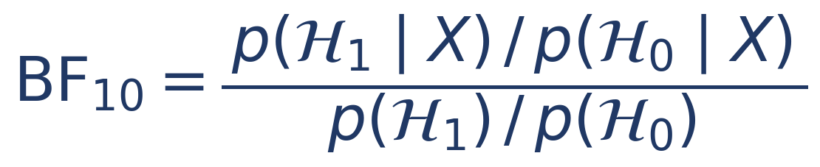
Output 2: testing for clustering
The clustering Bayes factor compares two hypotheses:

Slide 24
Output 2: testing for clustering
BF > 1 → evidence for clustering; BF < 1 → evidence against.
We can also compare two specific counts, e.g. B = 2 vs B = 3 (a point hypotheses Bayes factor).
Useful when theory predicts a particular number of clusters.

Slide 25
Output 3: which nodes cluster together?
Each MCMC iteration assigns nodes to blocks.
We summarize with the posterior mode and posterior mean allocation.

Slide 26
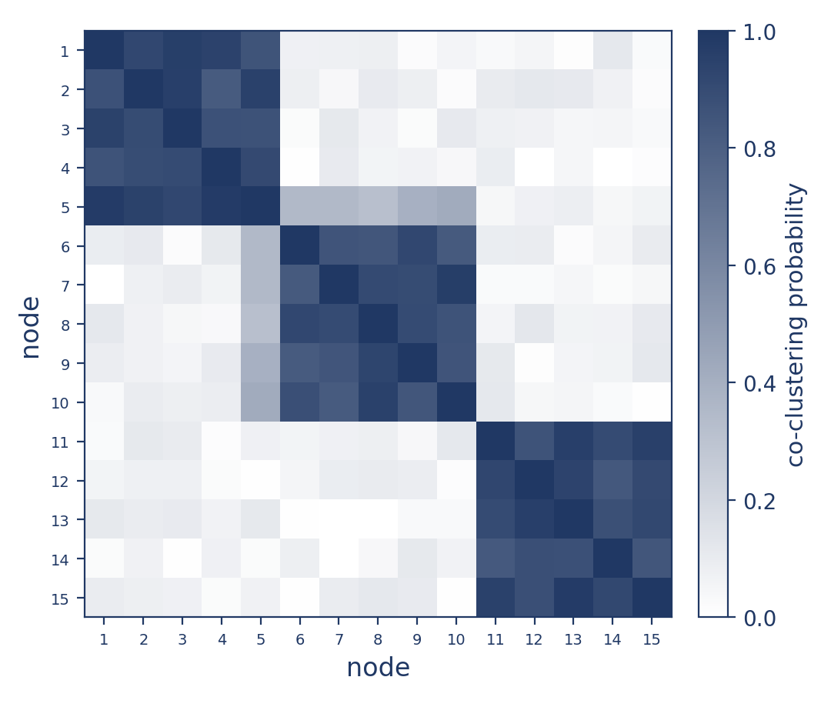
Output 3: the co-clustering matrix
For each pair of nodes: the proportion of iterations they shared a cluster.
Clear blocks = well-supported clusters; diffuse rows = unstable nodes (e.g. node 5).

Slide 27
Take-home: clustering as a testable hypothesis
The SBM prior turns a substantive theory (variables form clusters) into part of the statistical model.
We can estimate the clusters and test whether they exist, not just detect them post-hoc.

Slide 28
Bonus: where do the hyperparameters come from?
Choosing λ and the Beta shapes can be hard.
Recent work explores using large language models to elicit these priors from a description of the items and theory.
See: Sekulovski, Waaijers & Arena (2025), LLM-Based Prior Elicitation for Bayesian Graphical Modeling.

Slide 29
Session setup
Part I: Theory
Part II: Practical
Part III: Project
image: Flaticon.com

